Slide 1
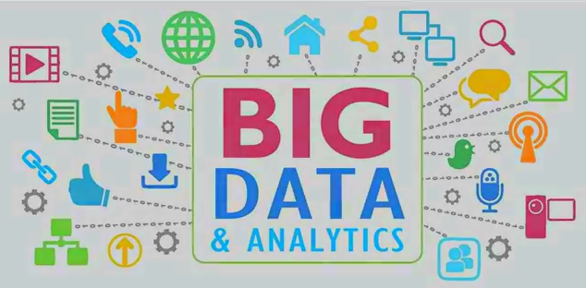
Big Data Engineering and Big Data Analytics

Slide 2
contents
Evolution of Big data
sources of Big Data
What is Big Data?
Characteristic of Big Data( 5 Vs)
Tools used in Big Data
Introduction to Big Data analytics
Big Data analytics goals
Applications/use cases of Big Data analytics
Challenges of Big Data
How Hadoop solves the Big Data problem

Slide 3
Big data engineering is the process of managing the ingestion and transformation of high volume data sets from various disparate sources within an organization
Big data analytics describes the process of uncovering trends, patterns, and correlations in large amounts of raw data to help make data-informed decisions

Slide 4
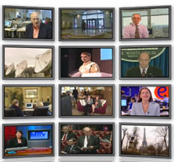
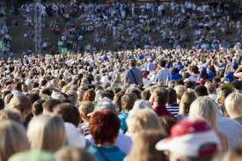


Evolution of Big Data
The Model of Generating/Consuming Data has Changed
Old Model: Few companies are generating data, all others are consuming data
New Model: all of us are generating data, and all of us are consuming data
Genet Shanko

Slide 5
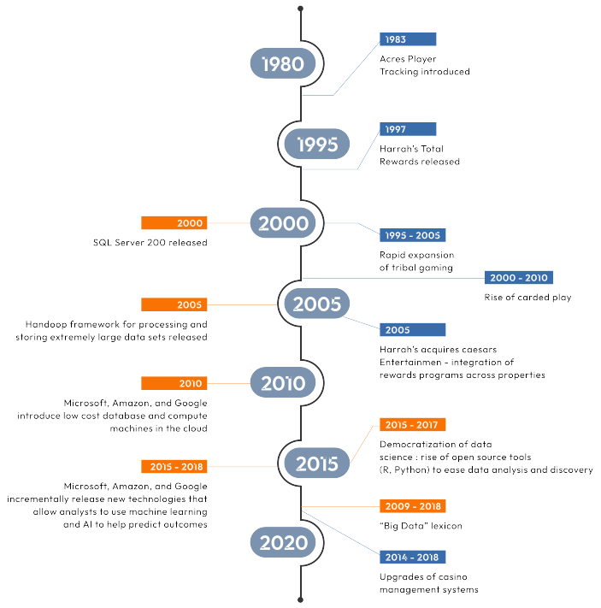

Slide 6
Unit of Data size | Exact size | Approximate Size | Examples
KB (kilobyte ) | 2 ¹⁰ or 1024 bytes | (10³ or one thousand) bytes | A typical joke =1KB
MB(megabyte ) | 2 ²⁰ bytes | (10⁶ or one million) bytes | Complete work of Shakespeare =5MB
GB (gigabyte ) | 2 ³⁰ bytes | (10⁹ or one billion) bytes | Ten yards of books on a shelf = 1GB
TB (terabyte) | 2 ⁴⁰ bytes | (10¹² or one trillion) bytes | All the X-rays for a large hospital =1TB Tweets; created daily =121TB;
PB (peta byte) | 2 ⁵⁰ bytes | (10¹⁵ or one quadrillion) bytes | All U.S. academic research libraries = 2PB Data processed in a day by Google =24PB | B I G D A T A
EB (exa byte) | 2 ⁶⁰ bytes | (10¹⁸ or one Quintillion) bytes | Total global data created in 2006 = 161EB
ZB (zetta byte) | 2 ⁷⁰ bytes | (10²¹ or one Sextillion) bytes | Total amount of global data created in 2012 = 2.7 ZB and 6.7 zettabytes (ZB) in 2020 to around 16 zettabytes in 2025.
YB (yotta byte) | 2 ⁸⁰ bytes | (10²⁴ or one Septillion) bytes

Slide 7
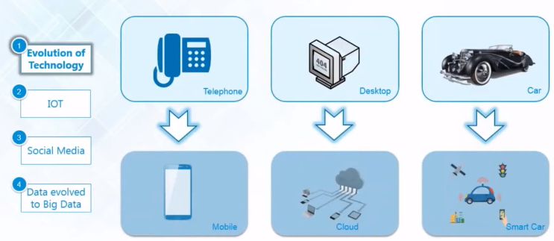
Evolution of Big Data by technology
Genet Shanko

Slide 8
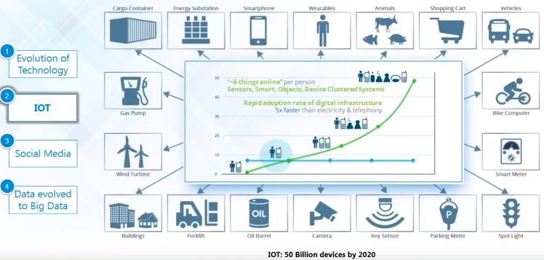
Evolution of Big Data by Internet Of Things
Genet Shanko

Slide 9
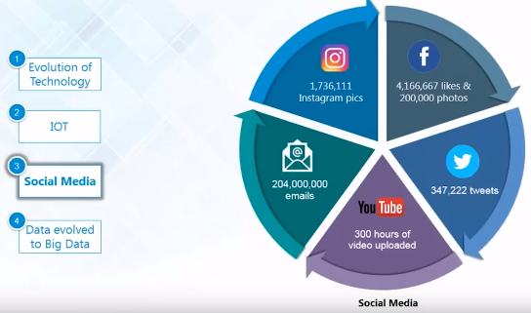
Evolution of Big Data by Social Media
Genet Shanko

Slide 10
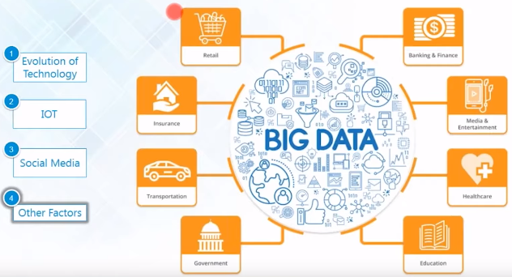
Evolution of Big Data by other factors
Genet Shanko

Slide 11
Big Data sources
Human Generated Data
is emails, documents, photos and tweets. We are generating this data faster than ever. Just imagine the number of videos uploaded to You Tube and tweets swirling around. This data can be Big Data too.
Machine Generated Data
is a new breed of data. This category consists of sensor data, and logs generated by 'machines'
such as email logs, click stream logs, etc. Machine generated data is orders of magnitude larger than Human Generated Data.
Genet Shanko

Slide 12
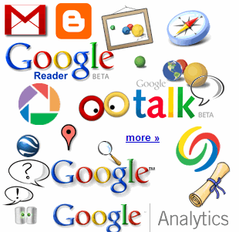


Big Data sources
Web Data
Social media data : Sites like Facebook, Twitter, LinkedIn generate a large amount of data
Click stream data : when users navigate a website, the clicks are logged for further analysis (like navigation patterns). Click stream data is important in on line advertising and E-Commerce
12+ TBs of tweet data every day
25+ TBs of log data every day
? TBs ofdata every day
Genet Shanko

Slide 13
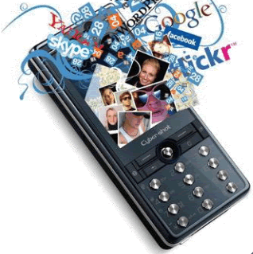

Big Data sources
sensor data : sensors embedded in roads to monitor traffic and misc.
30 billion RFID tags today (1.3B in 2005)
4.6 billion camera phones world wide
100s of millions of GPS enabled devices sold annually
2+ billion people on the Web by end 2011
76 million smart meters in 2009… 200M by 2014
Genet Shanko

Slide 14
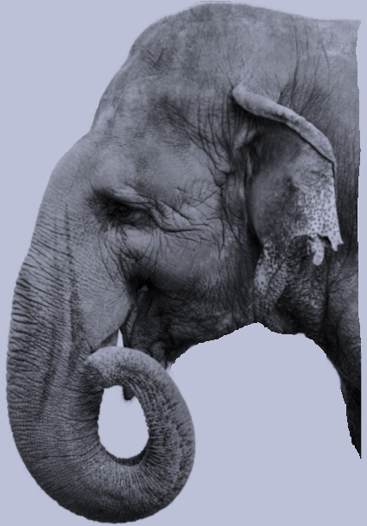
What is Big Data?
Big data
is the term for a collection of data sets so large and complex that it becomes difficult to process using traditional data processing applications.
Real world examples of Big Data
Facebook : has 40 PB of data and captures 100 TB / day
Yahoo : 60 PB of data
Twitter : 8 TB / day
EBay : 40 PB of data, captures 50TB/ day
Genet Shanko

Slide 15
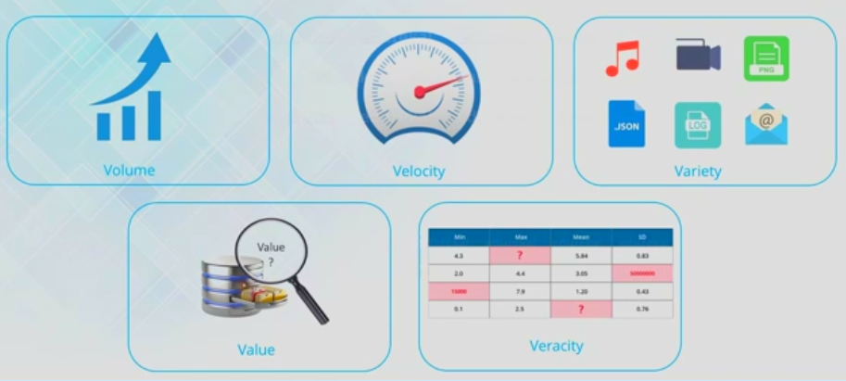
Characteristics of Big Data( 5 Vs of Big data )
Genet Shanko

Slide 16
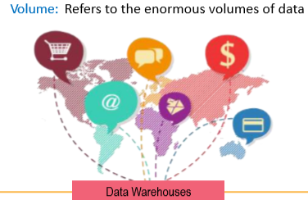
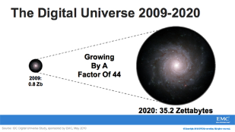
Characteristics of Big Data( 5 Vs of Big data )
1st V-volume
Data Volume
44x increase from 2009 to 2020 From 0.8 zettabytes to 35zb
Data volume is increasing exponentially
Genet Shanko

Slide 17
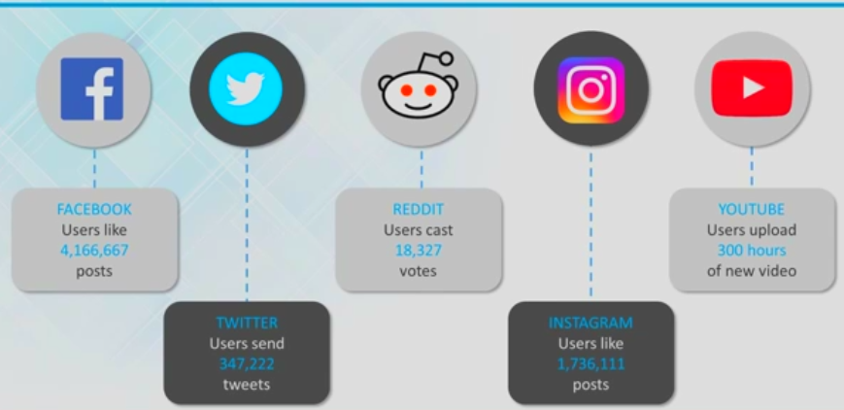
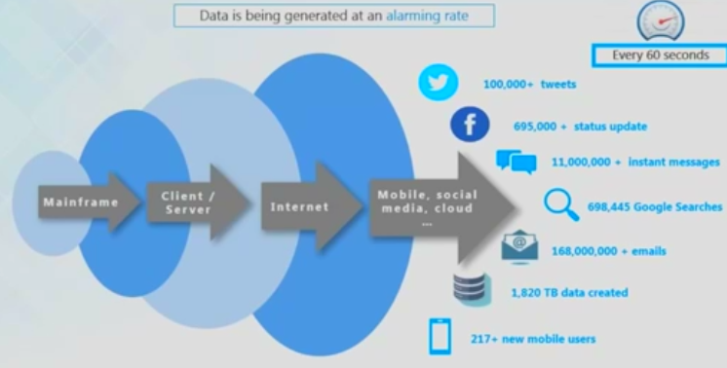
Characteristics of Big Data( 5 Vs of Big data )
2nd V-velocity: Data is being generated at every minute
Genet Shanko

Slide 18
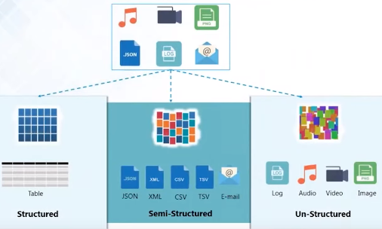
Characteristics of Big Data( 5 Vs of Big data )
3rd V-Variety: different kinds of data generated from various sources
Genet Shanko

Slide 19
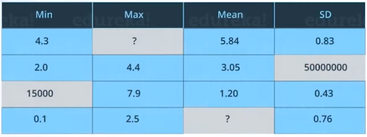
Characteristics of Big Data( 5 Vs of Big data )
4th V - Veracity: uncertainties and inconsistencies in big data
Genet Shanko

Slide 20
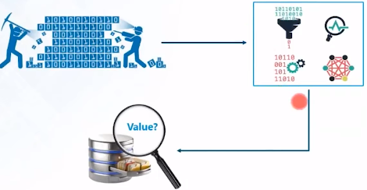
Characteristics of Big Data( 5 Vs of Big data )
5th V - Value: Mechanism to bring correct meaning out of the data
Genet Shanko

Slide 21
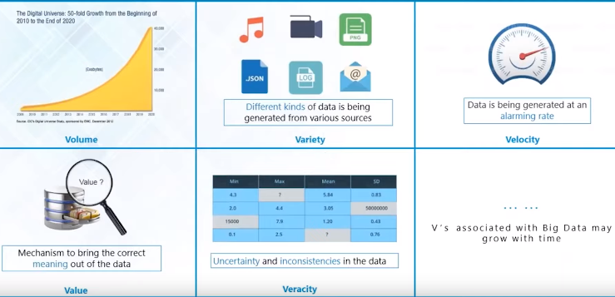
Characteristics of Big Data( 5 Vs of Big data )
Genet Shanko

Slide 22
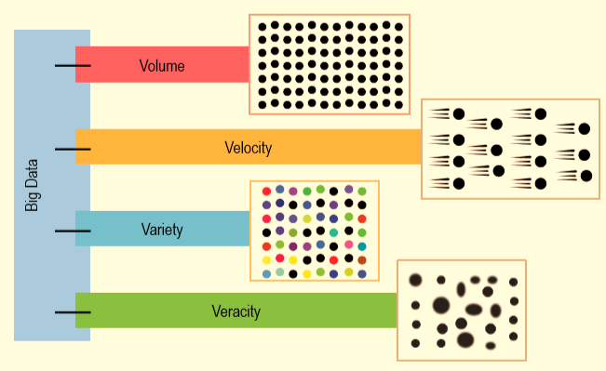
Characteristics of Big Data( 5 Vs of Big data )
Genet Shanko

Slide 23
Traditional DB vs Big Data
Traditional data base/
data warehouse
Big Data
Data
TB to PB
Only structured
Hardware
big central servers
Expensive
Hardware reliability
Limited scalability
Software
Centralized
Schema based
Oracle/mysql/sql server
Data
PB to ZB
structured and unstructured
Hardware
computer clusters
Cost effective
Unreliable HW
Scales further
Software
Distributed
Not schema based
Hadoop
Genet Shanko

Slide 24
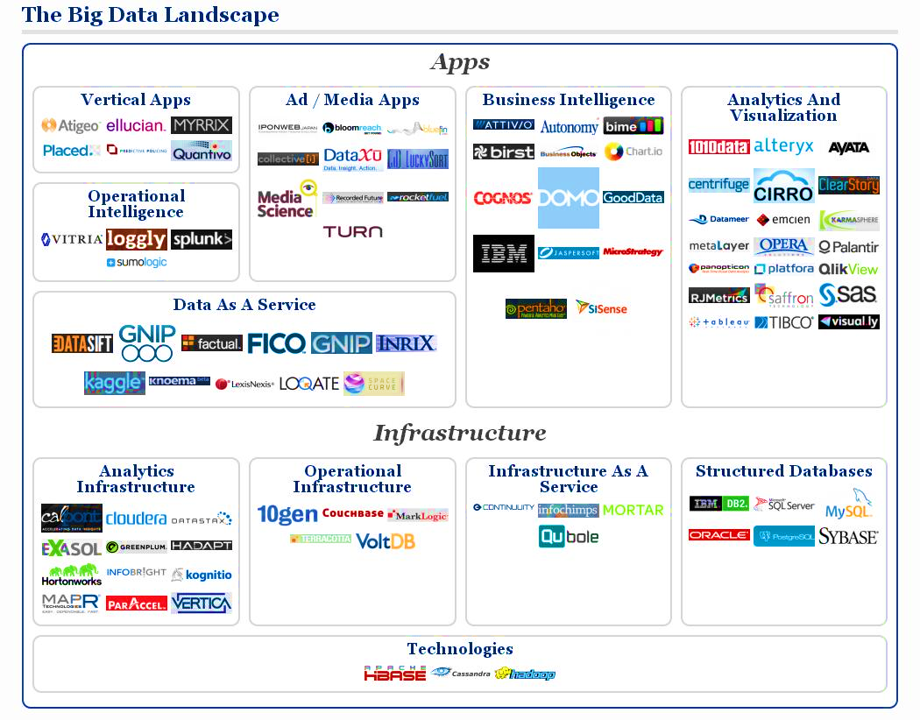
Big data tools

Slide 25
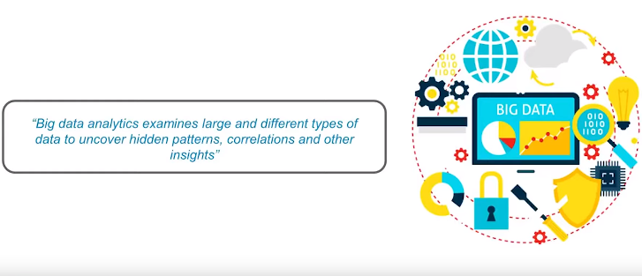
What is Big data analytics
Genet Shanko

Slide 26
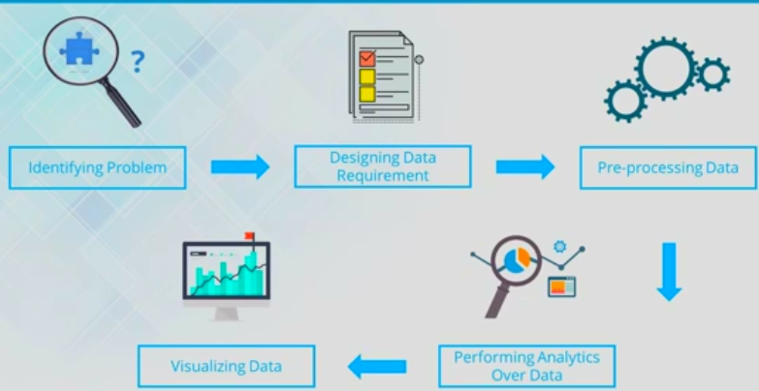
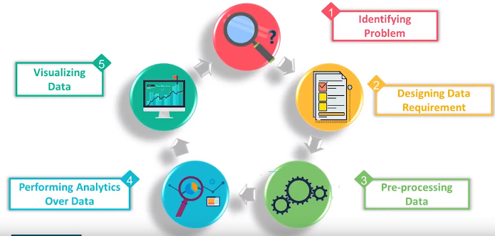
Stages in Big data analytics
Genet Shanko

Slide 27
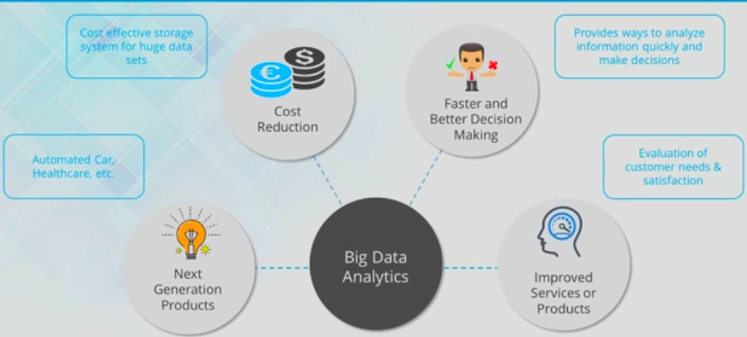
Big data analytics goals
Genet Shanko

Slide 28
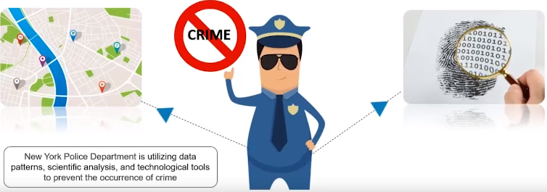
Big data analytics goals
1.Making organizations more smarter and efficient
Genet Shanko

Slide 29
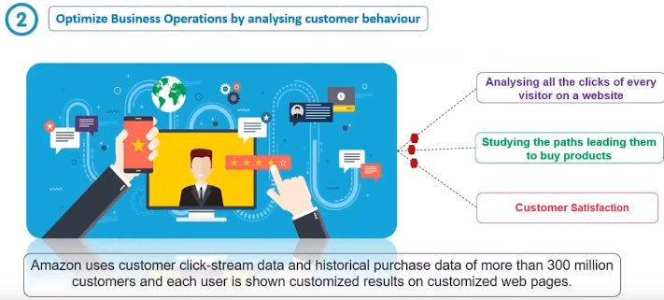
Big data analytics goals
1.Making organizations more smarter and efficient
Genet Shanko

Slide 30
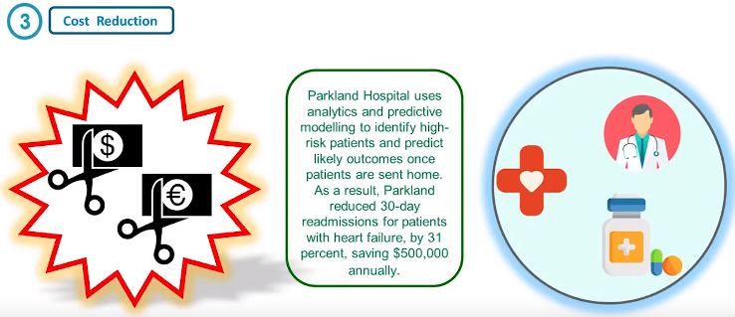
Big data analytics goals
Genet Shanko

Slide 31
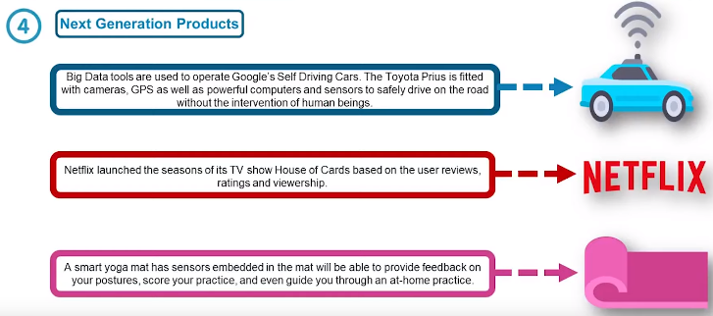
Big data analytics goals
Genet Shanko

Slide 32
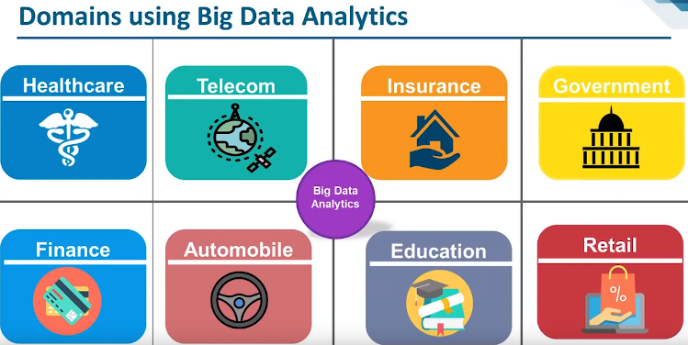
Big data analytics application domains
Genet Shanko

Slide 33
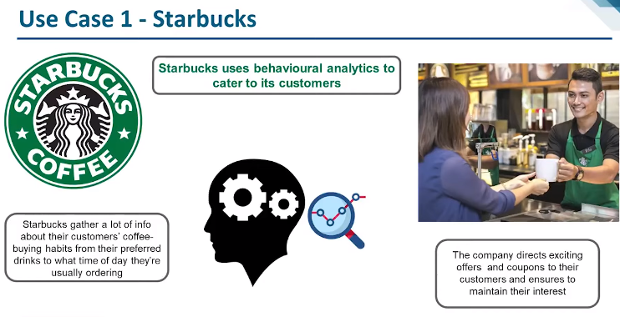
Big data analytics use cases
Genet Shanko

Slide 34
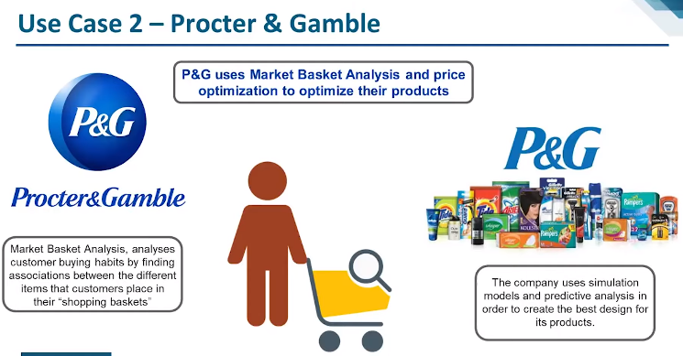
Big data analytics use cases
Genet Shanko

Slide 35
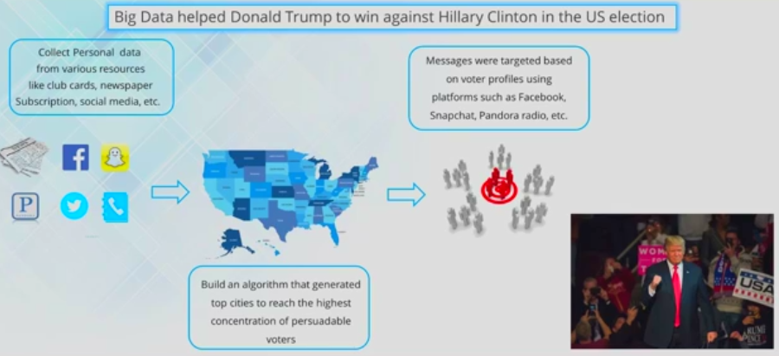
Big data analytics use cases
Genet Shanko

Slide 36
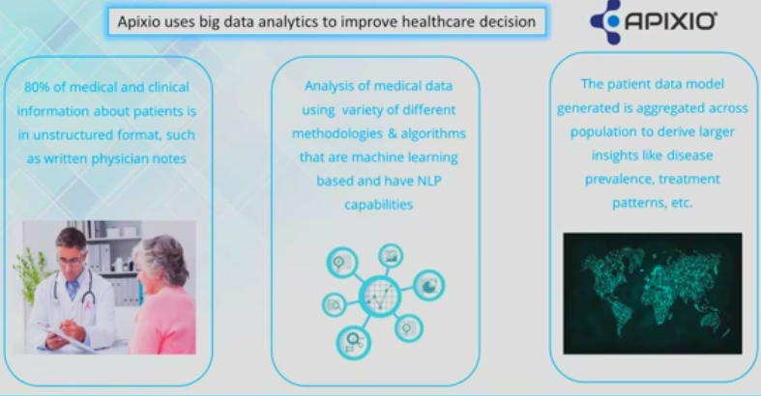
Big data analytics use cases
Genet Shanko

Slide 37
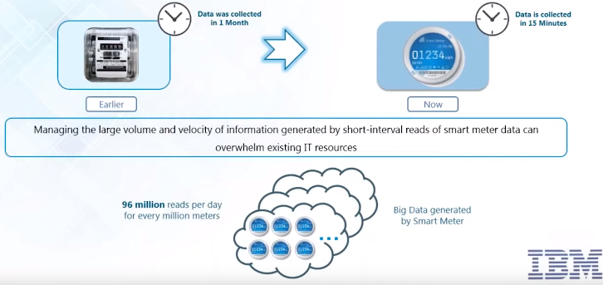
Big data analytics use cases
IBM Big data analytics – Big data collected by smart meters
Genet Shanko

Slide 38
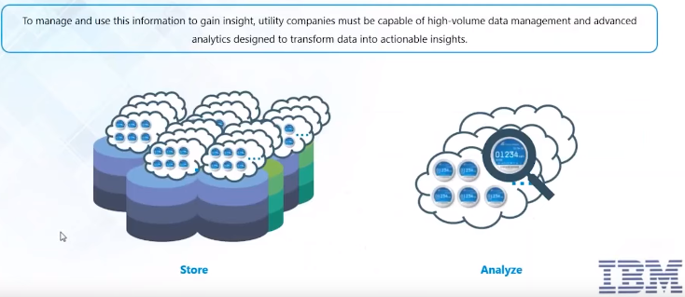
Big data analytics use cases
IBM Big data analytics – problem with smart meter big data
Genet Shanko

Slide 39
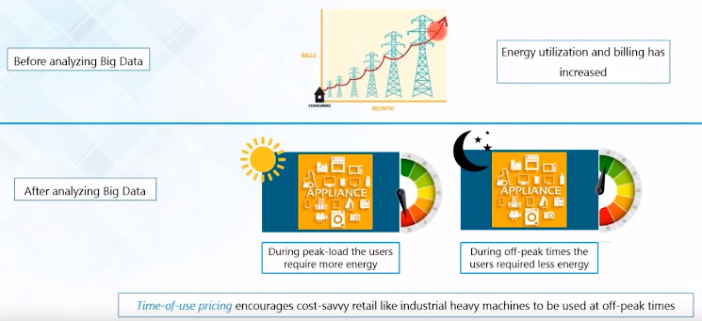
Big data analytics use cases
IBM Big data analytics – how smart meter big data analysed
Genet Shanko

Slide 40
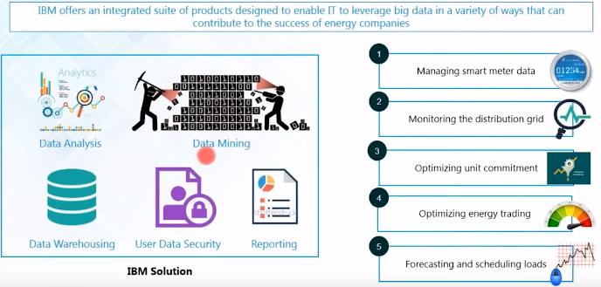
Big data analytics use cases
IBM Big data analytics – IBM smart meter solution
Genet Shanko

Slide 41
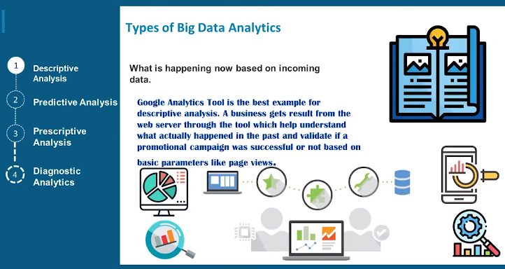
Types of Big data analytics
Genet Shanko

Slide 42
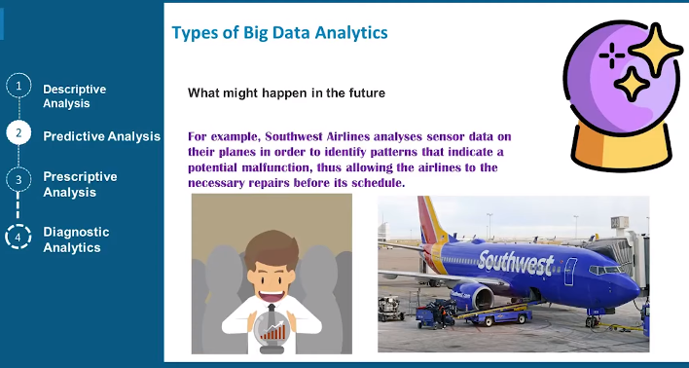
Types of Big data analytics
Genet Shanko

Slide 43
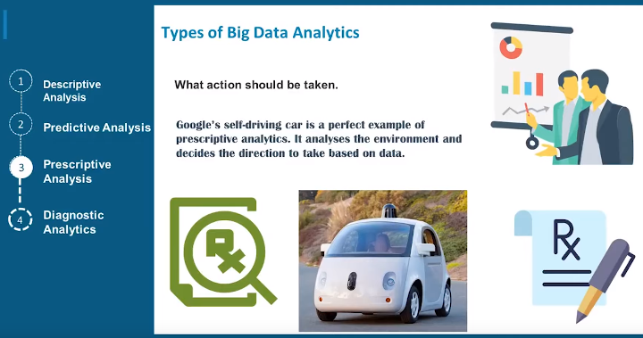
Types of Big data analytics
Genet Shanko

Slide 44
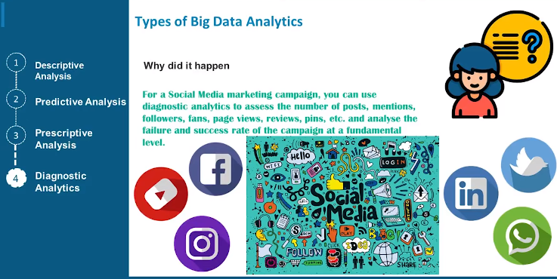
Types of Big data analytics
Genet Shanko

Slide 45
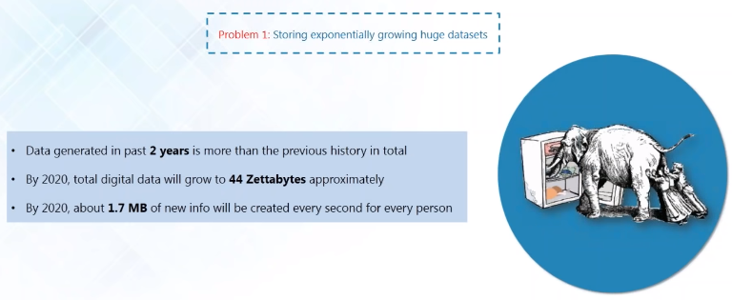
Challenges/problems with Big data
Genet Shanko

Slide 46
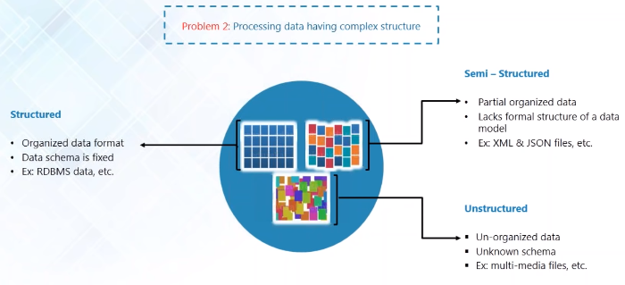
Challenges/problems with Big data
Genet Shanko

Slide 47
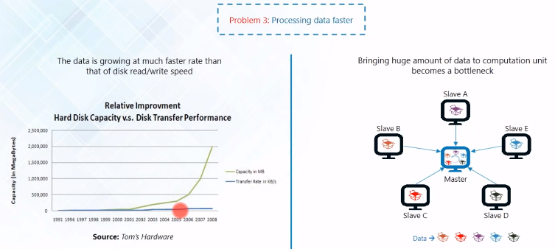
Challenges/problems with Big data
Genet Shanko

Slide 48
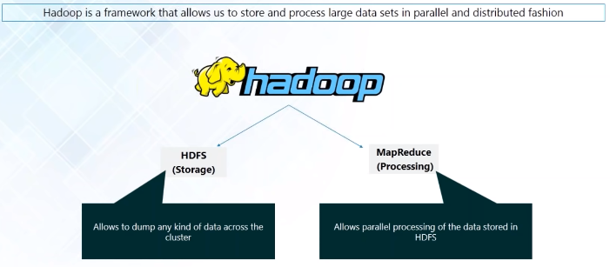
HADOOP is solution to Big data problems
Genet Shanko

Slide 49
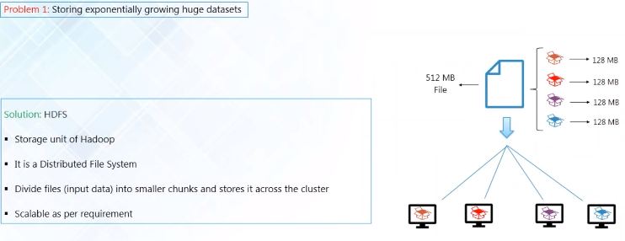
HADOOP is solution to Big data problems
Genet Shanko

Slide 50
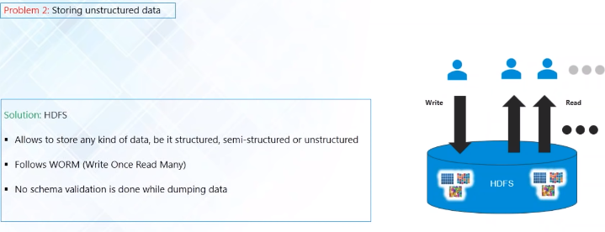
HADOOP is solution to Big data problems
Genet Shanko

Slide 51
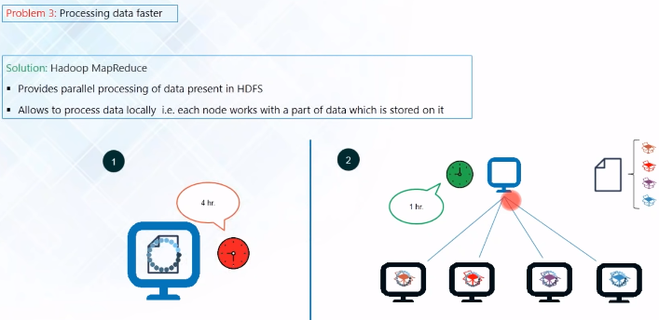
HADOOP is solution to Big data problems
Genet Shanko

Slide 52
Introduction to Big data and Analytics
ANY QUESTIONS / DOUBTS
???
Genet Shanko

